Slide 1

Red Centre Software and Phebi:
A New Approach to Text Analytics
Introduction by Ton Koster, Knowledge Navigators
Presentation by Dr Dale Chant, Red Centre Software
Marketing Insights Event, Netherlands Market Research Society
26 May 2021
Copyright Red Centre Software 2021
Contact: dale@redcentresoftware.com

Slide 2


Slide 3
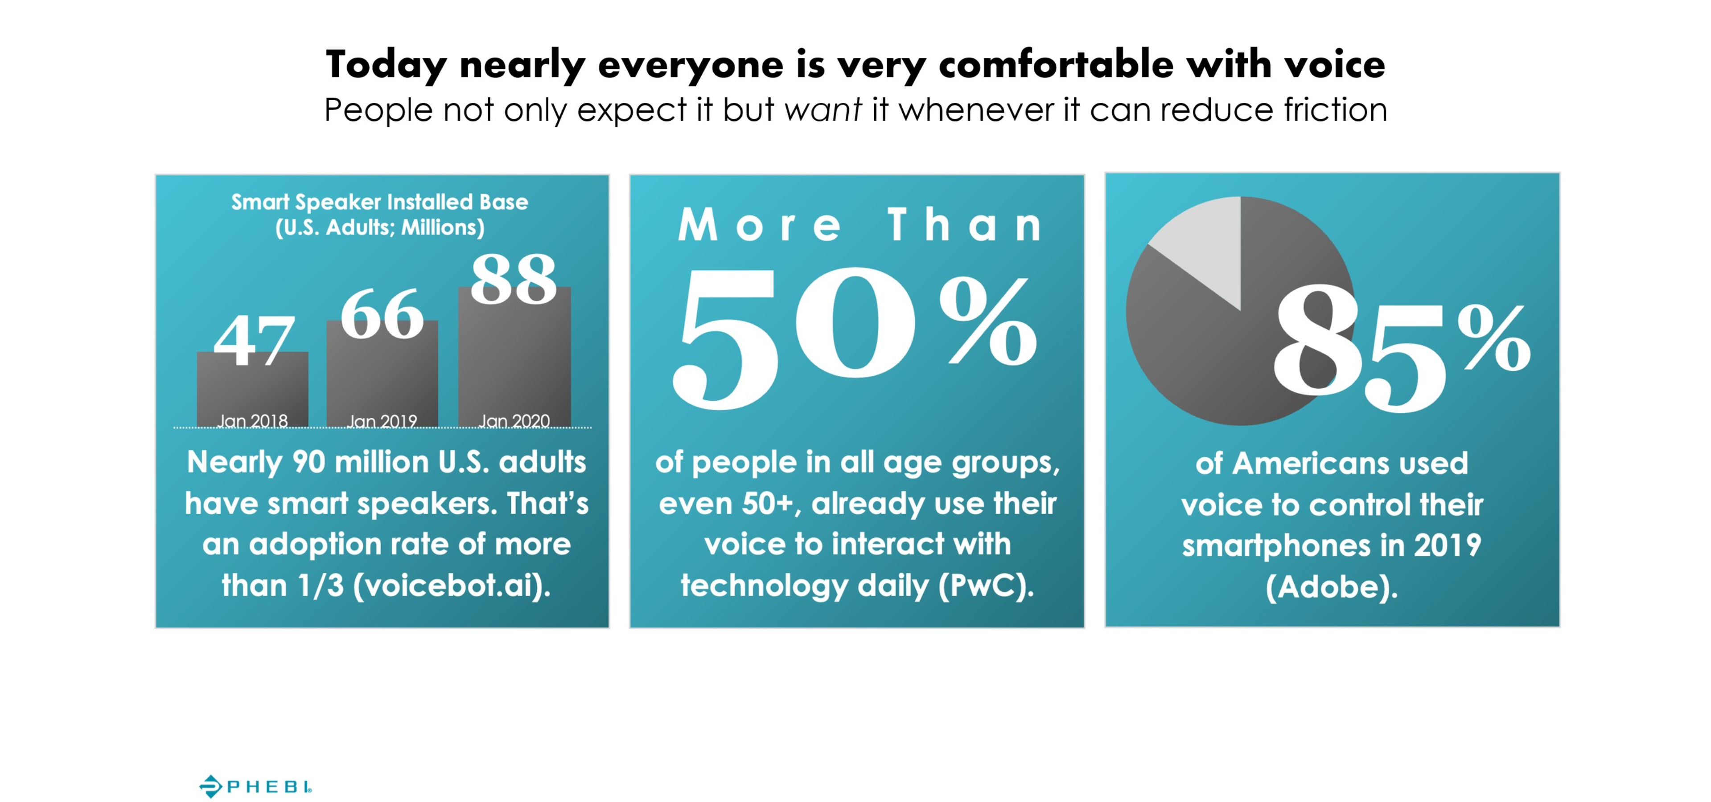

Slide 4
The Presentation
  Red Centre Software is working with Phebi to add enhanced text analytics for transcribed verbatims
  Within the MR world, RCS has advanced some novel approaches to text analytics
    Fuzzy text matching to extract narrative themes (Birks et al, 2013)
    Dictionaries for sentiment look-ups (IJMR, 2019)
    Handling huge twitter feeds (upcoming MRS Big Qual conference)
  This presentation looks at how the dictionary approach
    Addresses some inherent limitations in AI/ML text analytics
    Validates the proposition that audio is better (richer, deeper, more nuanced, sharper distinctions) than keyboard
    Can enrich verbatims analysis
  The survey is really a verbatim methodology test (audio vs free text vs text boxes) which
    Uses a classic product/packaging concept test as the data input, and
    Was fielded in German

Slide 5
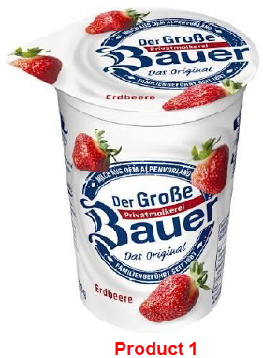
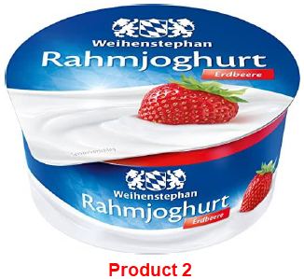
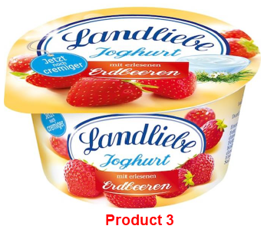
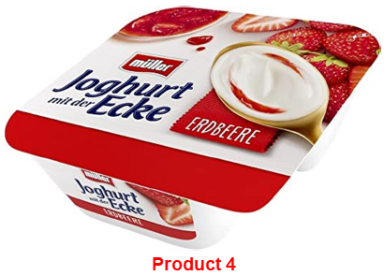
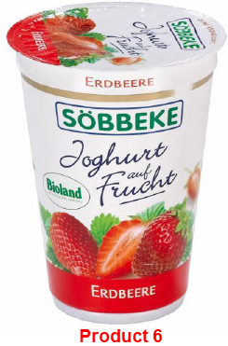
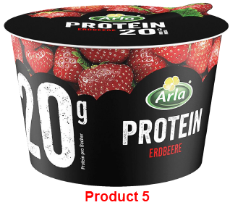
The Products

Slide 6
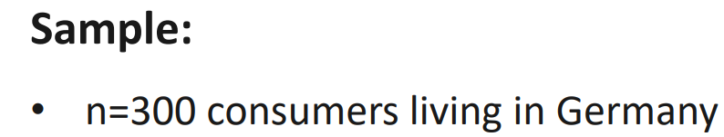
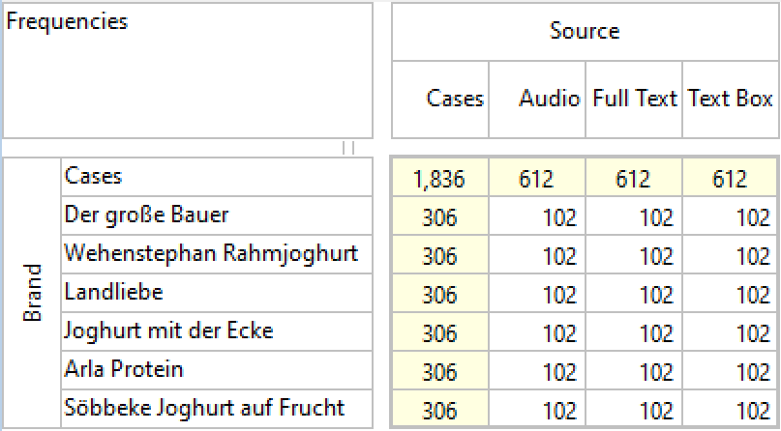
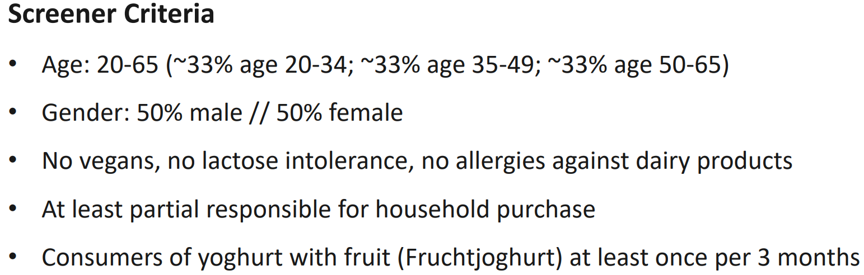
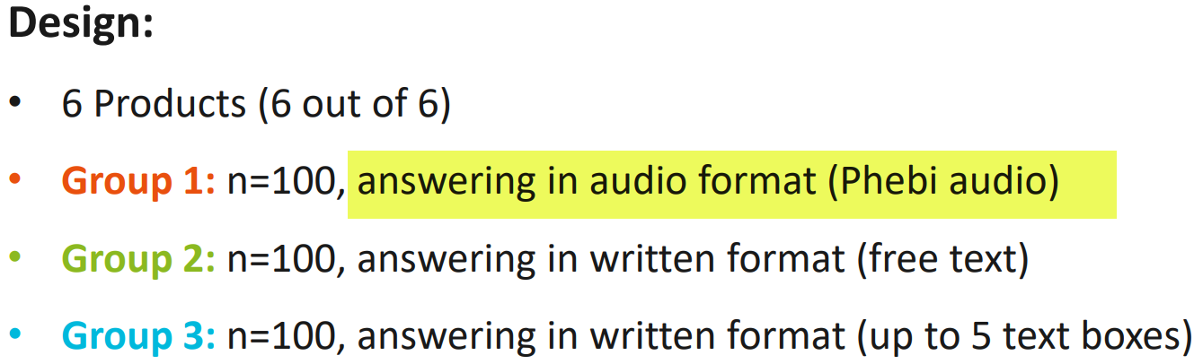
The Survey Design
Format by Brand:
100 respondents per source format per brand = 100*3*6 = 1,800 stacked cases
Plus 36 ‘noise’ verbatims for realism

Slide 7
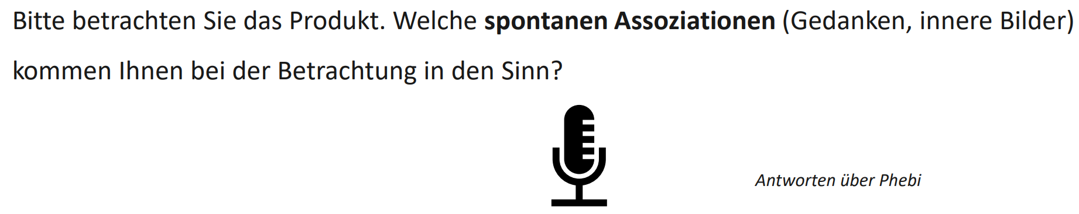
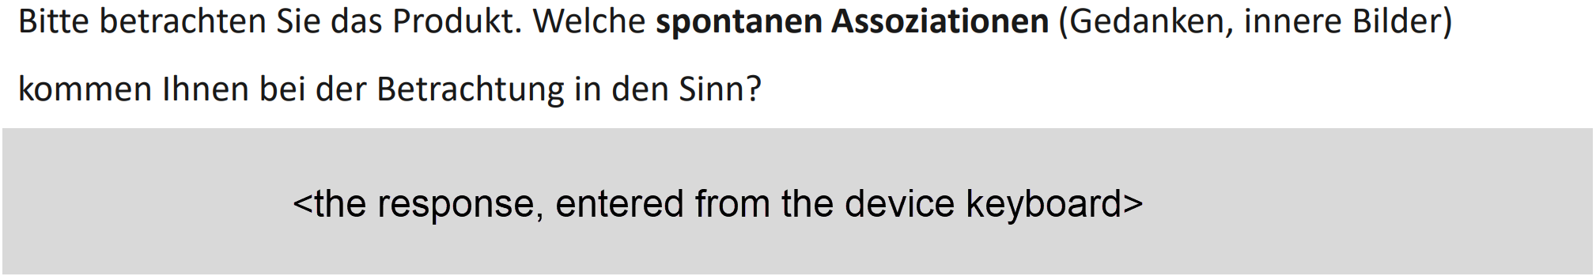
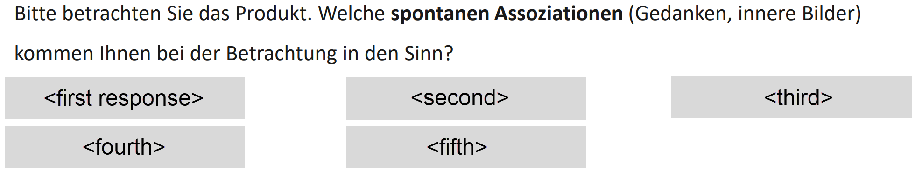
The Three Verbatim Collection Methods
Q2. Please consider the product. What spontaneous associations (thoughts, inner images) come to mind when you look at it?
Audio (1)
Free Text (2)
Text Boxes (3)

Slide 8
The Verbatim Variables
The variables of interest are
Q2 Assoziationen (Associations)
Q3 Gefaellt (Liking)
Q4 Verbesserungen (Enhancements as suggested by respondent)
Total DT Words = 42,903
/300 respondents = 143
/6 brands = 24 words per brand

Slide 9
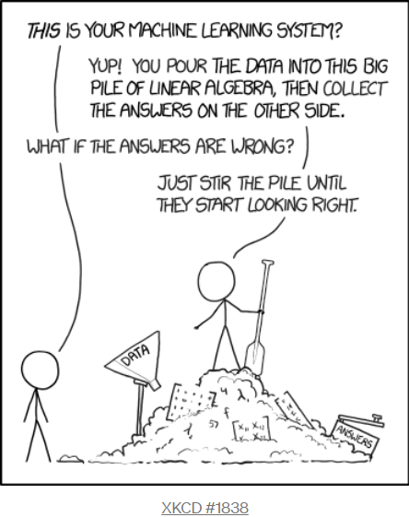
The Problem with AI/ML for
Text Sentiment Analysis
Needs a large training set – expensive human coders
Domain-specific – if trained on FMCG, not much use for political polling
Black box – cannot explain neural net
determinations to a client
Not useful for most small data sets

Slide 10
Alternatives: Two Different Dictionary Lookup Systems
1. Syuzhet
  Sum weighted words to a response score
  Dictionary: good = +1, bad = -1, love = +2
  For each verbatim
    For each word, look up its weight and sum to an overall score
  For example: Love is good = 2 + 1 = 3
2. NRC (National Research Council of Canada)
  Categorise words as subset of ten emotions: anger, sadness, joy, trust…
  For each verbatim
    For each word, look up its categories and merge to create a
    multi-response set
  “abandoned” is NRC-coded as anger, fear, negative and sadness
abandoned | anger | 1
abandoned | anticipation | 0
abandoned | disgust | 0
abandoned | fear | 1
abandoned | joy | 0
abandoned | negative | 1
abandoned | positive | 0
abandoned | sadness | 1

Slide 11
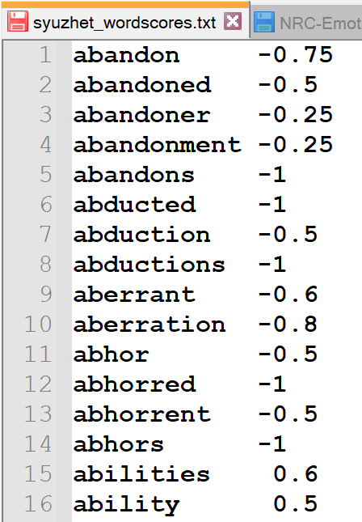
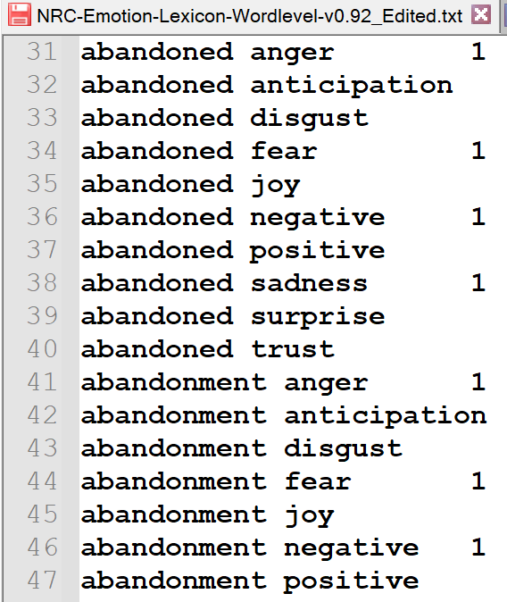
Pros and Cons
Pros:
Works on a single case (no training)
Transparent processing (can reproduce with pen and paper)
The dictionaries (as text files) can be edited/extended as required
Analytically robust (as will be demonstrated)
Cons:
Some false positives – no accounting for context or negation

Slide 12
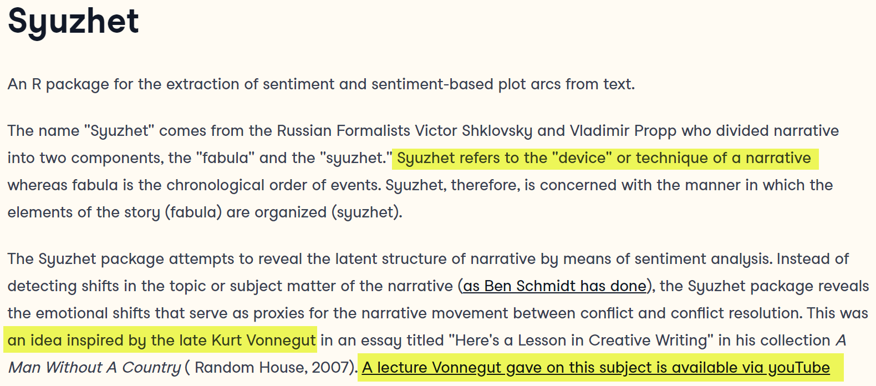
Academic Backing: Syuzhet
The Syuzhet lexicon was developed by the Nebraska University Literary Lab under direction of Matthew L. Jockers, Professor of English and Data Analytics at Washington State University
It is available as an R package at
  https://www.rdocumentation.org/packages/syuzhet/versions/1.0.6
(from URL)

Slide 13
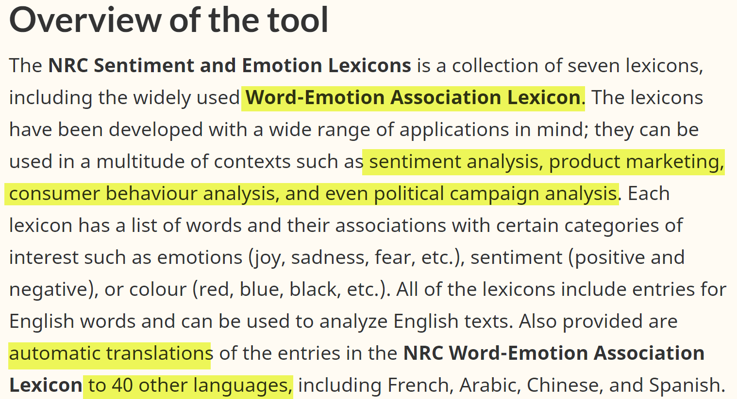
Academic Backing: NRC Categories
https://nrc.canada.ca/en/research-development/products-services/technical-advisory-services/sentiment-emotion-lexicons
(from URL)
The NRC lexicon is included in the R Syuzhet package. Non-commercial use is free.

Slide 14
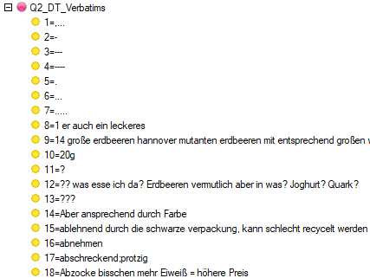
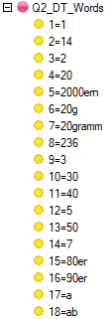
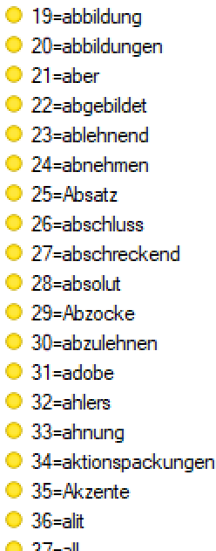

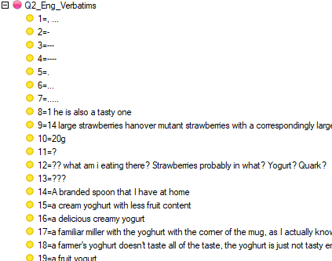
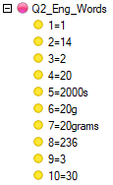
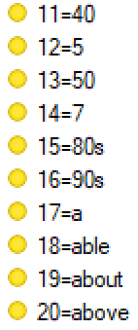
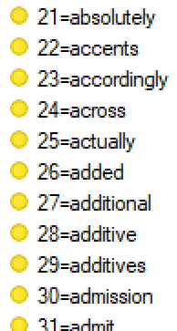
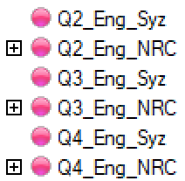
Processing the Phebi SAV
Input .SAV variables
Merge text
Break out DT words
(up to five responses)
Translate
Break out Eng words
Outputs
Repeat for Q3 and Q4
Apply dictionaries

Slide 15
Language Issues
Have used English translations of the verbatims
Alternatively, could translate the dictionaries to German
However, that does not improve accuracy much
  The key sentiment words have the same basic meanings in most languages
  The Dictionary approach necessarily ignores grammar in all languages
And translating (via google Translate) has benefits:
  Handles minor original language typos and spelling mistakes
  Lsngweiliges (is corrected to) -> Langweiliges (then translated to) -> Boring
  Maps original language synonyms to a common target word (netting), increasing hit rates
    Cremig and Sahnig both translate to creamy
  Facilitates consistent analysis and reporting across different language locales

Slide 16
Hypothesis: Audio is Better
Assessment Criteria:
Longer responses (data volume)
More emotion-bearing words (data signal)
Enables sharper distinctions (data resolution)

Slide 17
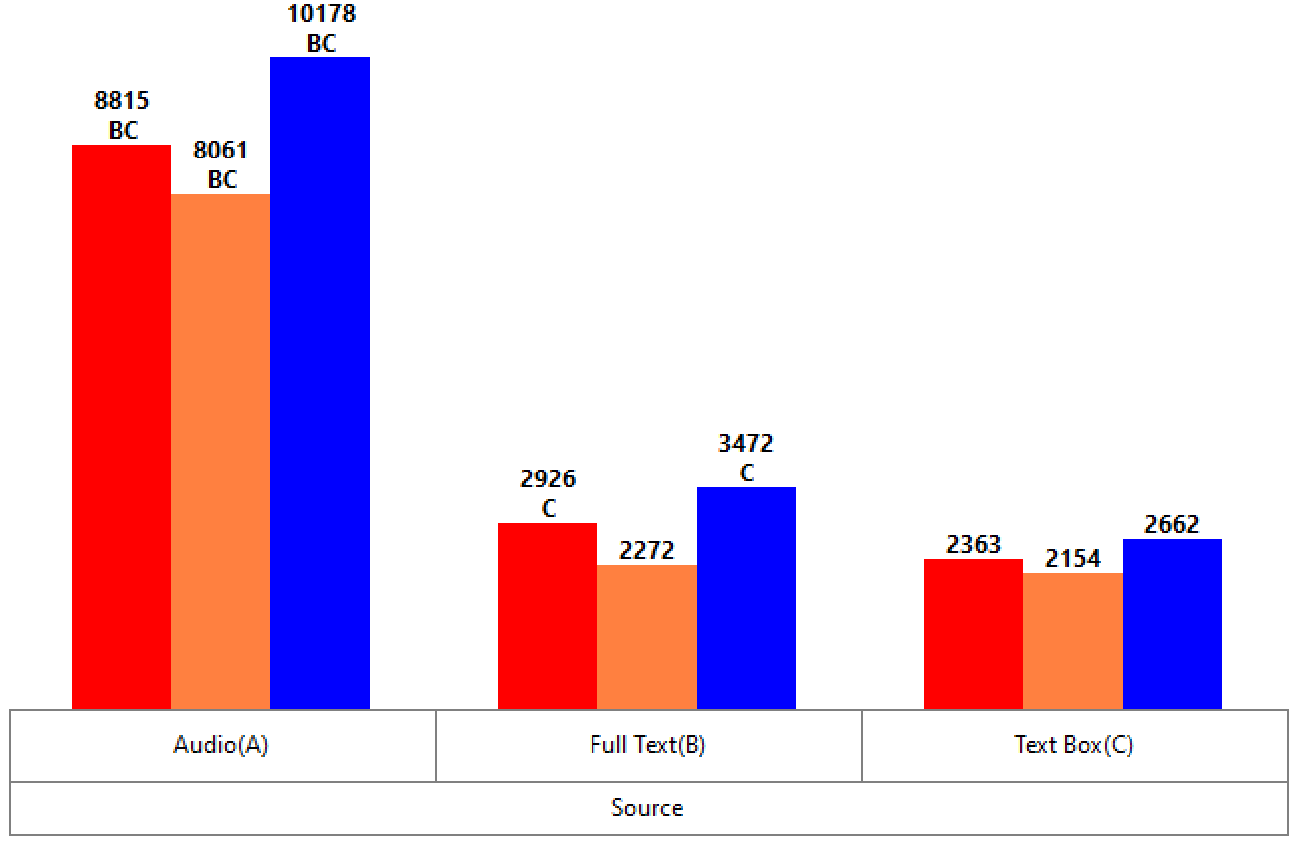
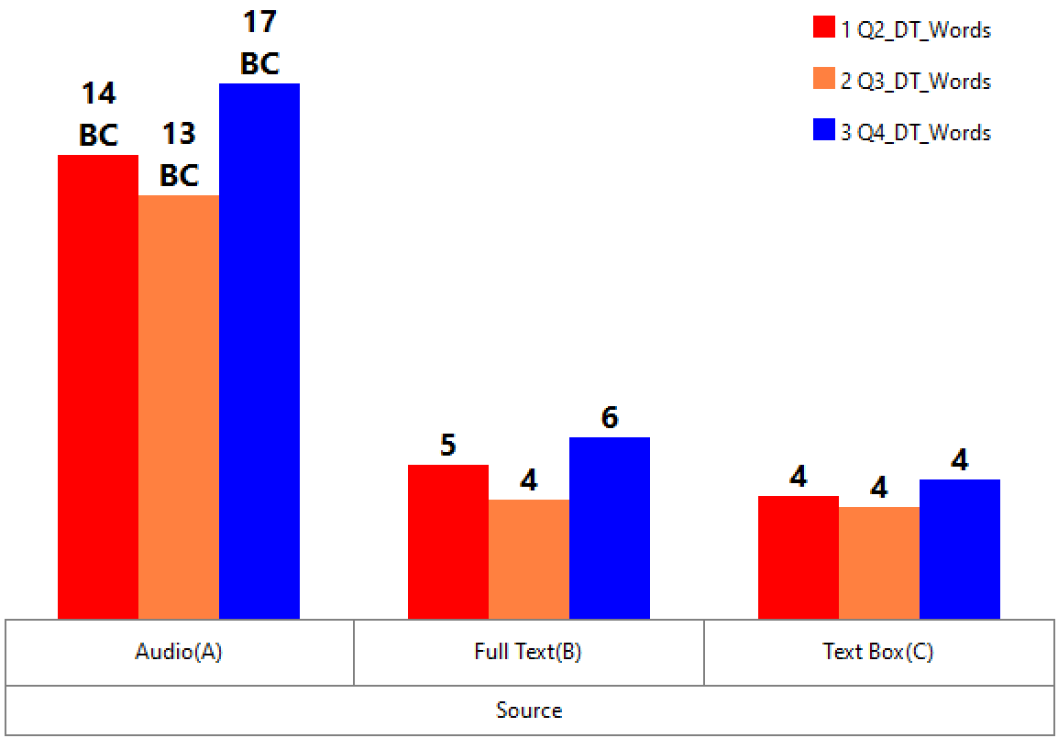
Longer Responses
Using the original German verbatims, Audio provides at least three times more raw data
Audio is significantly higher at the 99% level
Totals: 27,054 8,670 7,179
Averages: 15 5 4

Slide 18
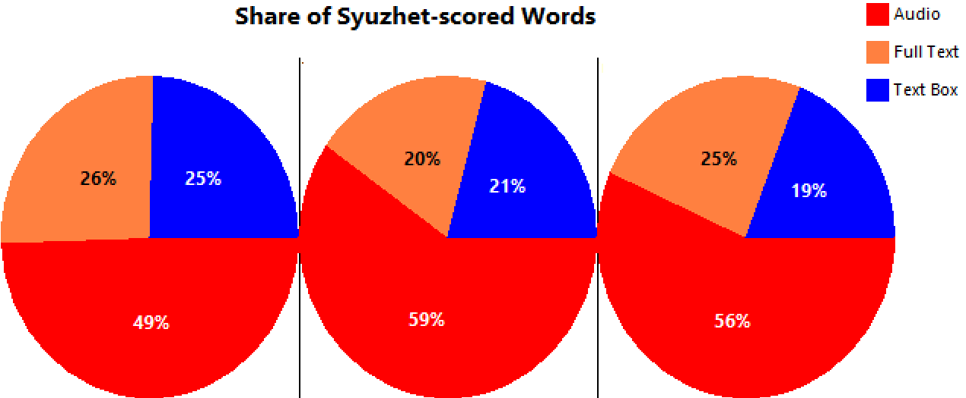
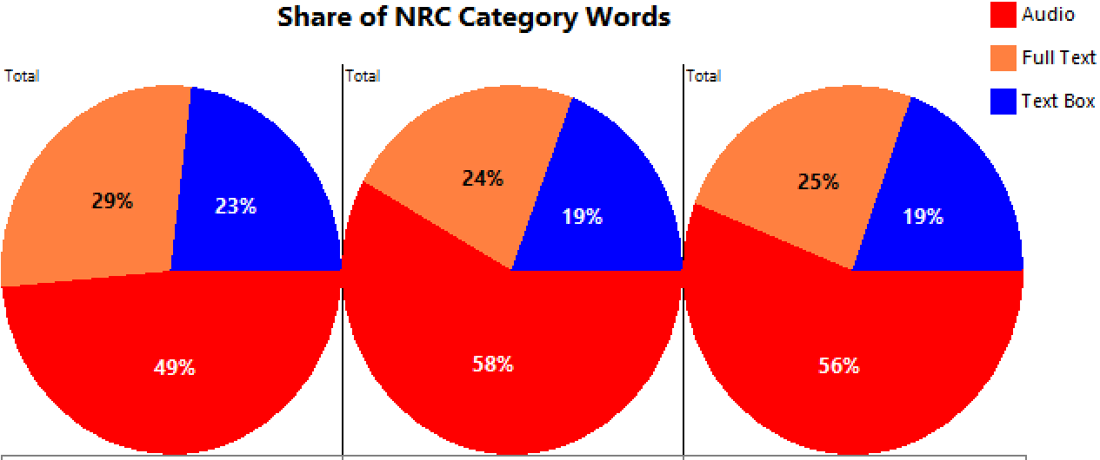
More Emotion-bearing Words: Share of Words
More words, but are they useful words?
Over half the useful words are from the Audio one third of the cases
55% of all Syuzhet-scored words are from the Audio collection
54% of all NRC categorized words are from the Audio collection
Q2 Assoc Q3 Like Q4 Enhance

Slide 19
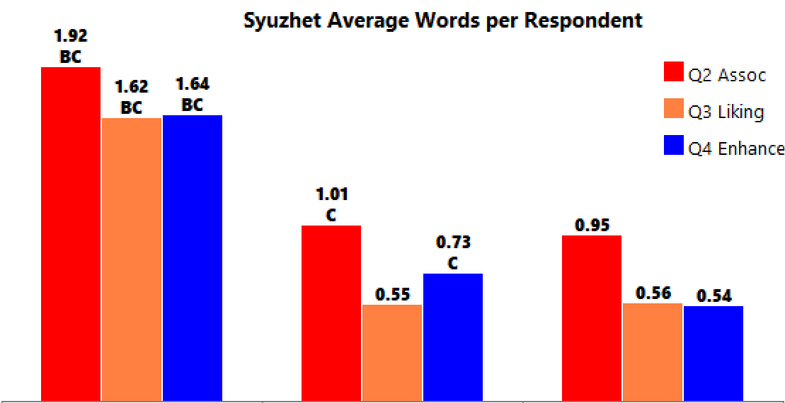
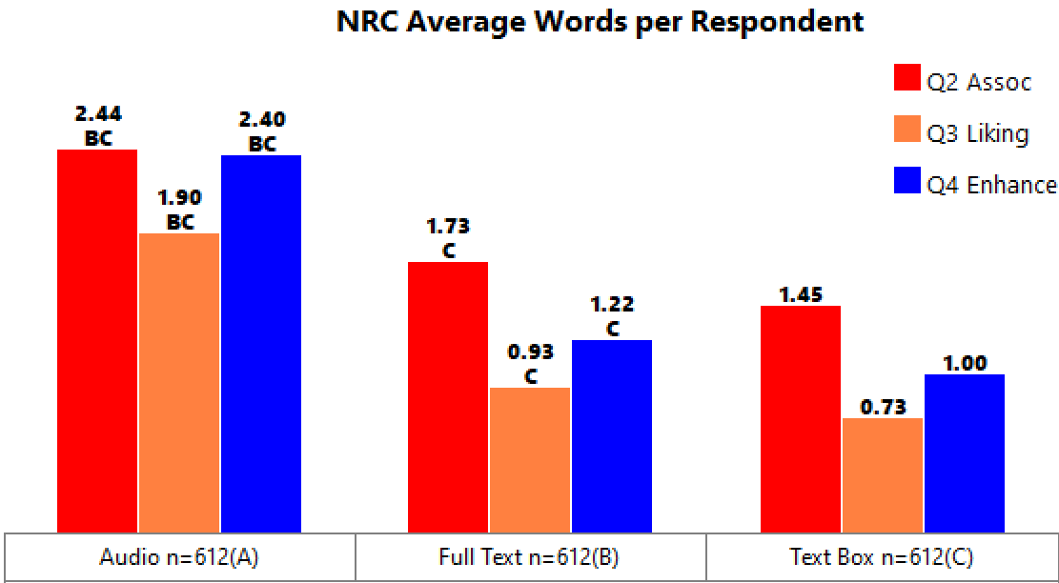
More Emotion-bearing Words: Proportion of Cases
1.73 as ratio of (0.76+0.68)/2 = 2.4 times greater emotion payload for Audio Syuzhet
Avg:
1.73
0.76
0.68
2.25 as ratio of (1.29+1.06)/2 = 1.92 times greater emotion payload for Audio NRC
2.25
1.29
1.06

Slide 20
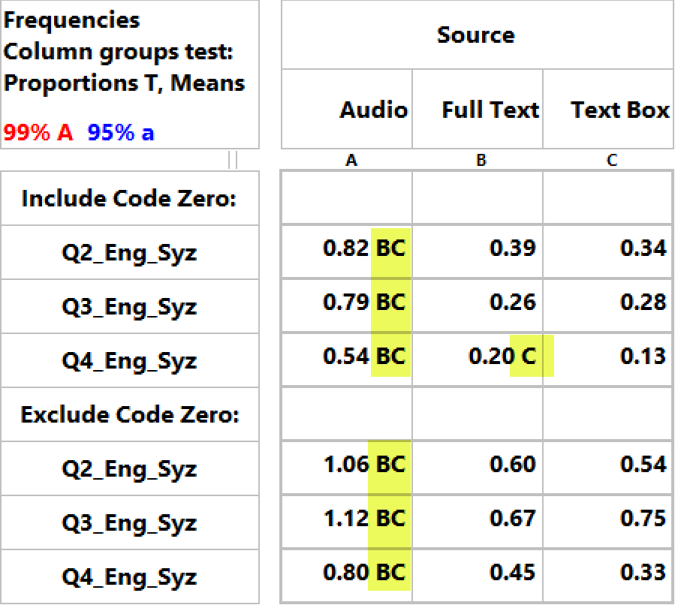
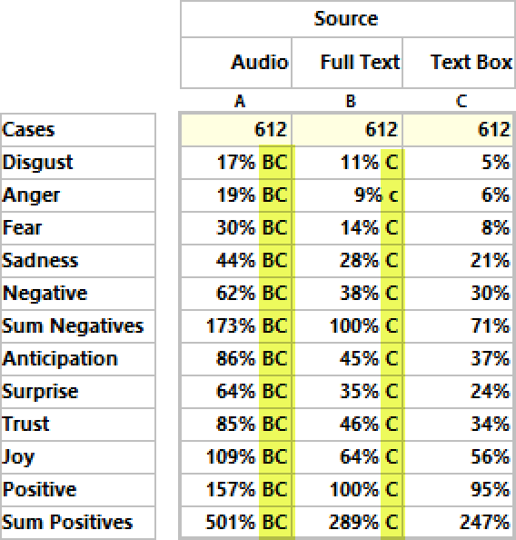
Sharper Distinctions (1):
Audio Syuzhet has two to three times greater mean positivity
at the 99% significance level
Overall, on all NRC emotion categories, Audio is significantly higher (at 99%) than both Full Text and Text Box.
Mean Syuzhet Score:
NRC Column Percents:

Slide 21
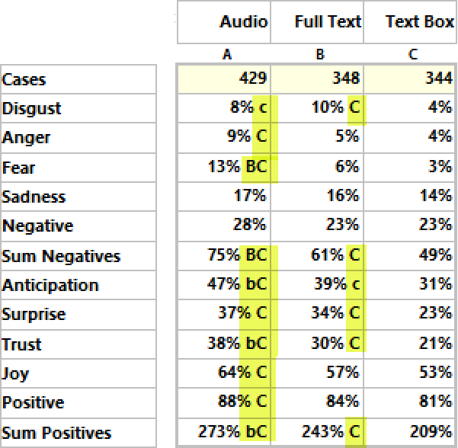
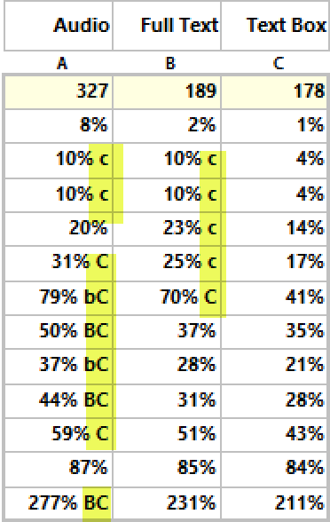
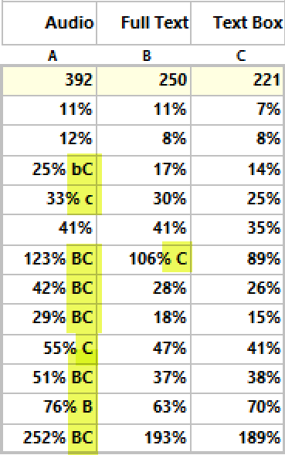
Sharper Distinctions (2): Q2/3/4 Breakouts
NRC Column Percents
Q2 Assoc
Q3 Liking
Q4 Enhance
Audio remains significantly higher for most categories, although at reduced levels due to smaller bases

Slide 22
Is Audio Better? - Yes
Criteria:
Longer responses
More emotion-bearing words
Sharper distinctions
(And Text Box is the worst)
Next, we’ll look at the product test brands. Can Syuzhet and NRC help us to make better sense of the 43,000 words in terms of respondent key concerns and general brand disposition?

Slide 23
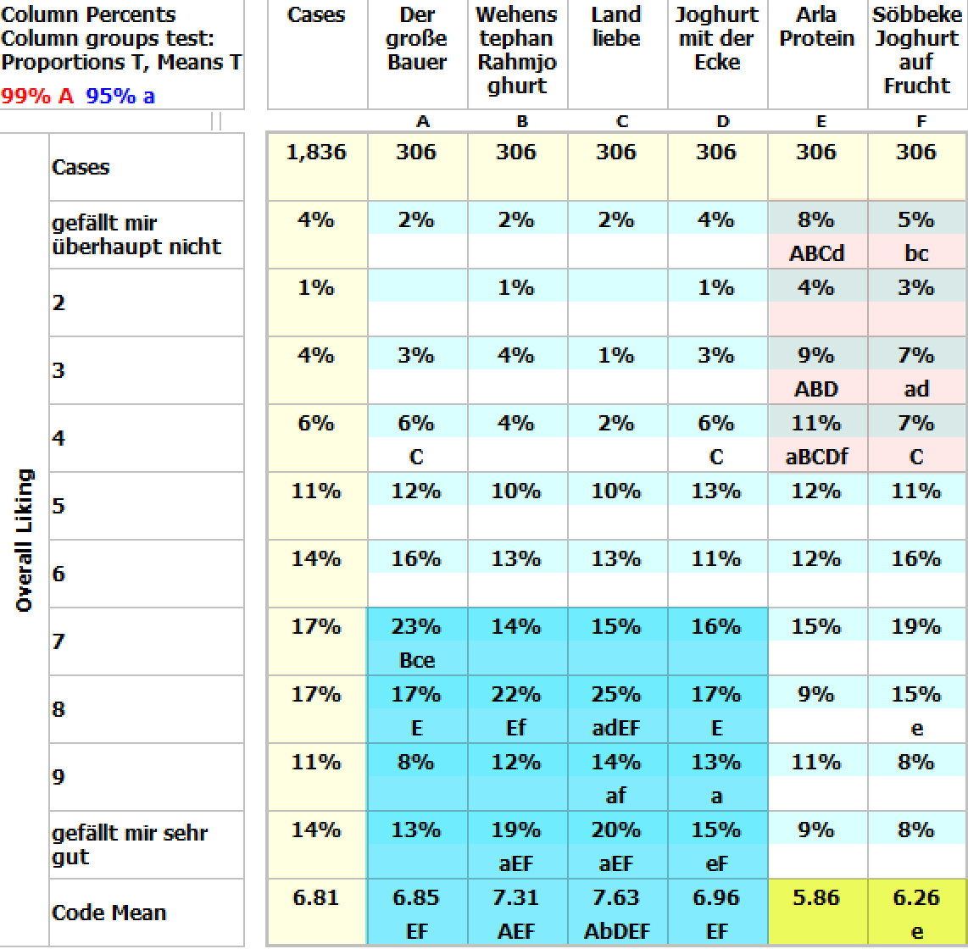
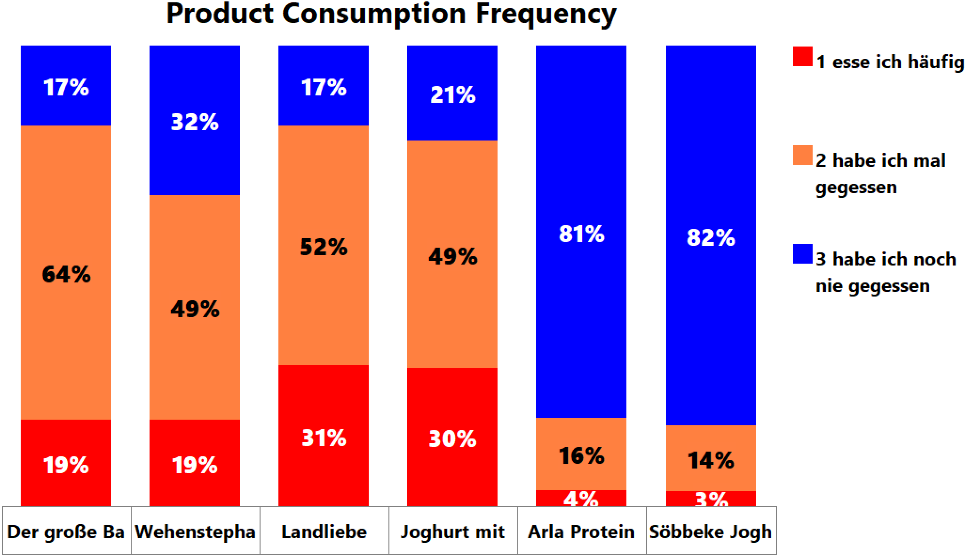
Arla and Söbbeke are Least Liked/Used
Arla and Söbbeke are significantly disliked
Over 80% have never consumed
Do Syuzhet and NRC support/explain this?

Slide 24
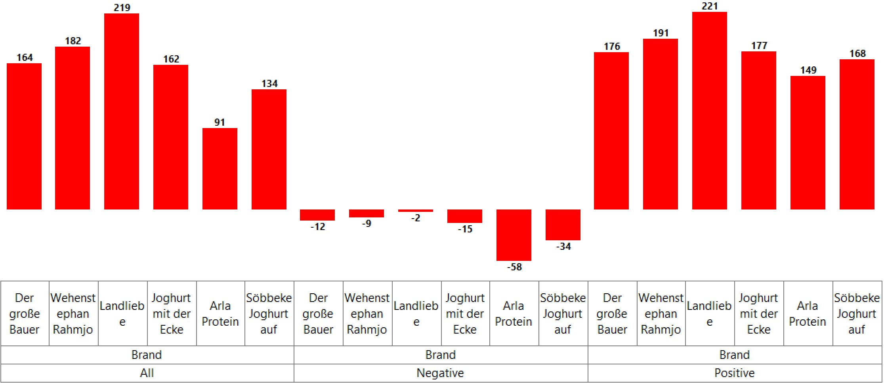
Syuzhet on Q2 Agrees:
Arla is overall lowest, the most negative and least positive, followed by Söbbeke

Slide 25
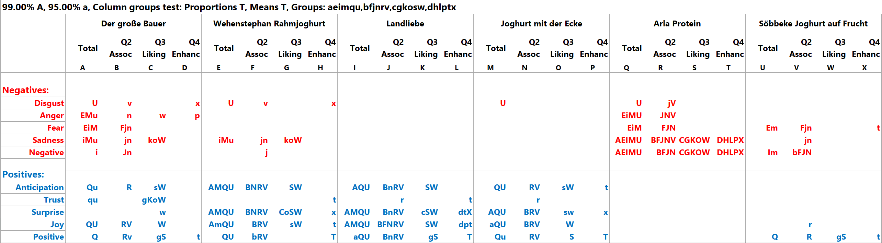
NRC on Q2 Agrees
Showing only the significance levels:
Verbatim NRC within Brand
Conflicted
Tends Positive
Strong Positive
Strong Positive
Strong Negative
Tends Negative

Slide 26
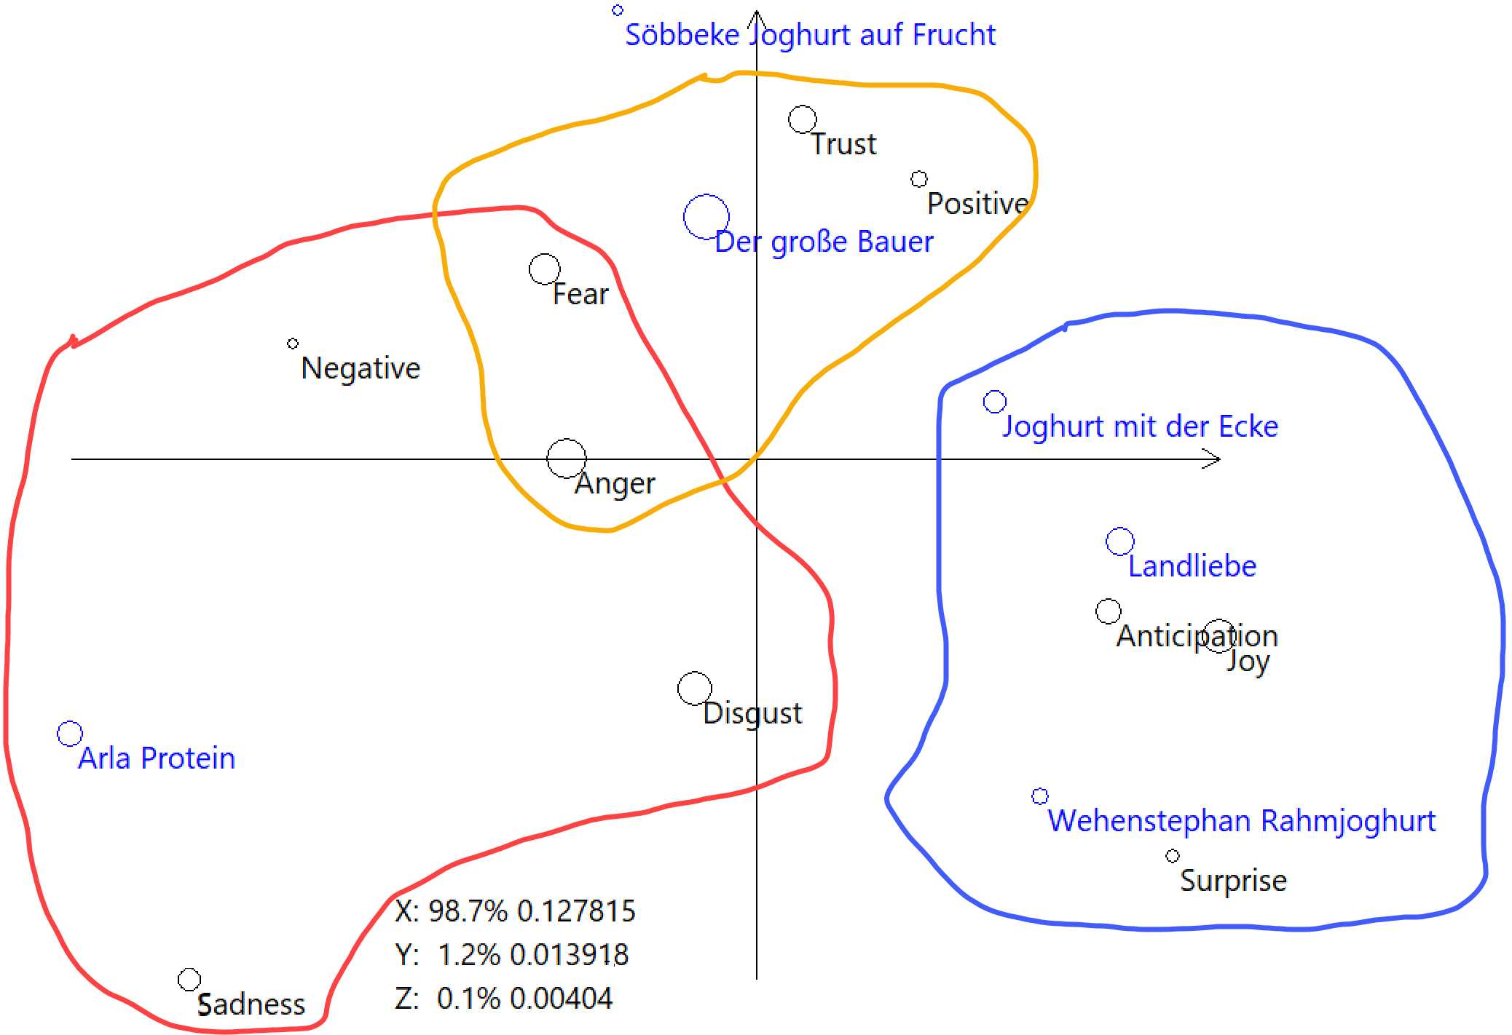
Correspondence Analysis on Q2 NRC Agrees
And likewise for Q3 and Q4…

Slide 27
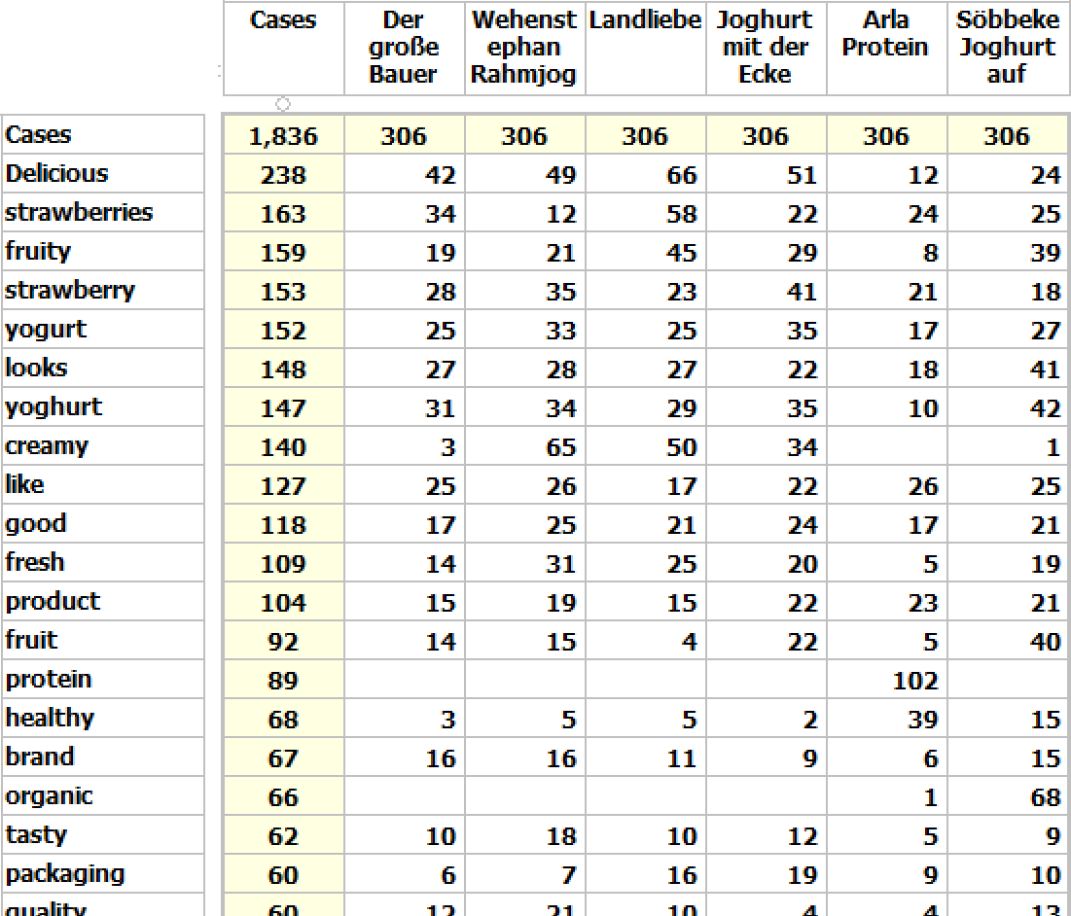
Drill Down: Word Frequencies
Verbatim words can be sorted by frequency to help identify themes, concerns and messages
Delicious, fruity, fresh strawberries in yoghurt – healthy and tasty
Big Farmer, Arla and Söbbeke are weak to nothing on creamy
Protein and organic both apply to only one brand each, so not thematic

Slide 28
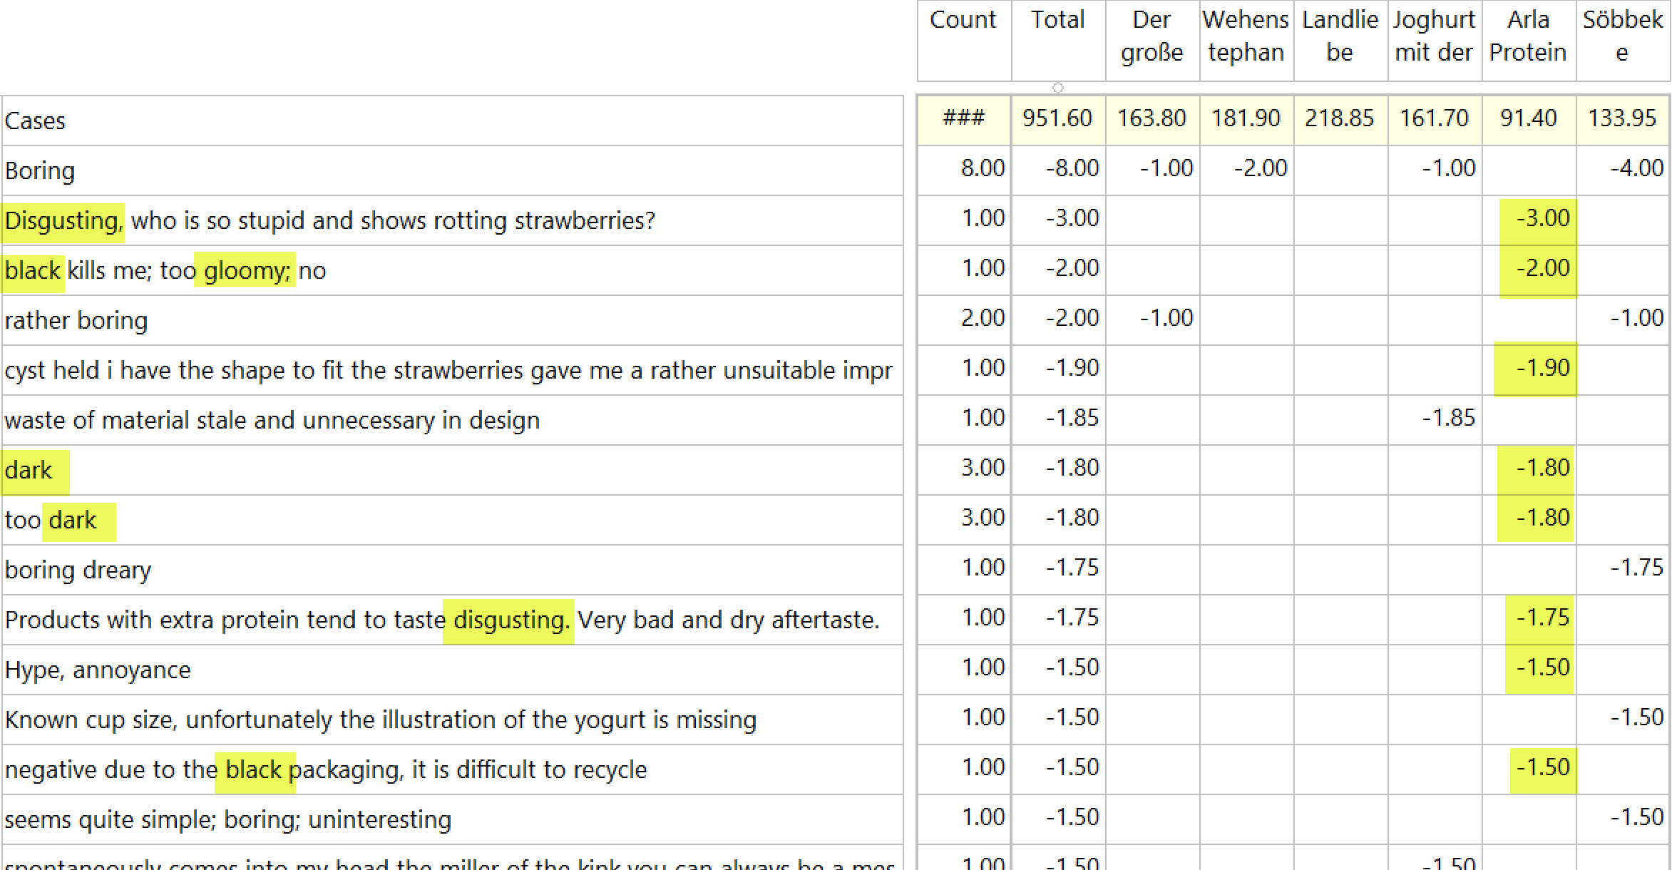
Drill Down: Syuzhet
The verbatims can be sorted by Syuzhet score and NRC category for human review
This indicates why Arla attracts negative sentiment

Slide 29
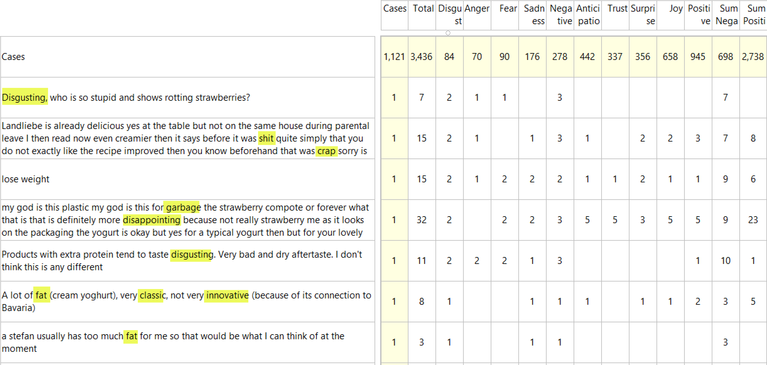
Drill Down: NRC

Slide 30
Conclusions
Audio carries a bigger and better emotional payload
The Syuzhet and NRC dictionaries provide a versatile and general-purpose way to extract and analyse emotional sentiment from text
For further information on Phebi: TKoster@knowledge-navigators-research.com
For further information on Red Centre Software products and services: Dale@RedCentreSoftware.com

