Slide 1
ASC Rebuilding Bridges
Eliminating
Dr Dale Chant
Director,
Red Centre Software
Association for Survey Computing, Conference presentation,
11 November 2021
www.redcentresoftware.com

Slide 2
Intentions
Macro: some observations on how the current move to an integrated modular services architecture obviates the need for many bridges
Meso: how the MR activity can be reimagined as a set of (mostly) de-bridged services
Micro: some live examples which use non-survey data
Conference themes:
How thought leaders are connecting survey platforms and data with the wider world.
How to provide greater insight by using non-survey data to contextualise the information captured in surveys, and vice versa

Slide 3
Macro: The Big Picture
1970s: UNIX/C, COBOL, mainframes
1980s: Home computers, IBM PC (released 1981)
By 1990 in MR a PC on every desk, floppy disks, MS-DOS
By 1995 Windows GUI OS+Excel/Word/PPT were the primary business tools
The age of the Big Fat App (BFA) – horizontal, tries to anticipate at least most user requirements
But marketing demand for new features to differentiate from competition and encourage upgrades meant ever bigger and fatter
Which led to vast and confusing GUIs

Slide 4
The Problem with BFAs
A GUI necessarily limits functionality
Thus, the BFAs needed scripting facilities to extend functionality (COM, VBA) against unforeseen requirements
After bootstrapping to our present state, do we still need the BFAs?
The answer from the new cloud-oriented world is No:
  too complicated
  weak security
  onerous learning curve
  functional duplication (API/GUI)
  scope creep
  backward compatibility
  asynchronous
  unstable
  difficult/impossible to integrate BFAs – only recourse is bridges, eg between SPSS and Excel (clipboard, CSV, COM - half worked, but Windows only)
The key consideration is how to integrate, because without INTEGRATION first, collaboration is a data-transfer mess.

Slide 5
The Evolving Solution: Services + APIs
A service is a self-contained unit of computer work which does one part or step of a larger process (and does it well)
The required doing is specified by the service’s API
Services
  raise the level of abstraction for creating integrated, composite or collaborative business applications
    increased responsiveness to change (agility)
    reduced complexity
    reusability – no more reinventing the wheel
APIs are powerful
  data transmutability
  bi-directional interaction
  leverage within other systems
  discoverability
Historically, services means web protocols only. We still want desktop, but it’s the style of architectural thinking that matters – of self-contained work units integrated via their APIs
Need to cover both, and hopefully with the same binary objects
Work unit1: Get case data
Work unit2: Run tables
Work unit3: Export

Slide 6
The Bezos Memo (c. 2002) – The Bridge Destroyer
Amazon mainstreamed the services approach by demonstrating how well it worked.
The Bezos memo has attained mythic status. Old style managers would never think of this.
All teams will henceforth expose their data and functionality through service interfaces [APIs].
Teams must communicate with each other through these interfaces.
There will be no other form of inter-process communication allowed: no direct linking, no direct reads of another team’s data store, no shared-memory model, no back-doors whatsoever. The only communication allowed is via service interface calls over the network.
It doesn’t matter what technology they use. HTTP, Corba, Pubsub, custom protocols — doesn’t matter.
All service interfaces, without exception, must be designed from the ground up to be externalizable. That is to say, teams must plan and design to be able to expose the interface to developers in the outside world. No exceptions.
Anyone who doesn’t do this will be fired.
Thank you; have a nice day!
Many cite this memo as the biggest single reason for Amazon’s success

Slide 7
Why was this a Big Deal?
Internally, no bridges and no barriers. 100% integration of all business functions. Any division could get any information it needed from any other division instantly (no pleading emails, no miscommunications, no office politics over information control).
Externally, using the public services anyone could set up as an Amazon retailer (the Amazon Marketplace).
AWS as a set of services for creating web apps basically wrote itself as extensions of the already implemented services

Slide 8
Responsive to Change
Recent developments at MS are to modularise MS Office functionality
Microsoft first unveiled Fluid (renamed Loop) last year, showing how the framework allows blocks of Office content to live independently across the web. That idea is now becoming a reality, with collaborative content that can be copied, pasted, and shared with others.
Instead of tables, graphs, and lists that are static and bound to specific documents, Fluid [Loop] components are collaborative modules that exist across different applications.
https://www.theverge.com/2021/6/17/22538144/microsoft-fluid-components-documents-office-teams-onenote-outlook-whiteboard
The slogan is “Close the Loop” – same as remove the need for bridges

Slide 9

Excel Services API
Microsoft has introduced several new standard JavaScript interfaces (APIs) [for Excel].
“We are building this API with the world of services in mind. We want to make it easy for you as a developer to extend any service and easily expose your data to Excel through your add-in.”
https://www.zdnet.com/article/microsoft-wants-to-take-excel-beyond-numbers-and-text/
Ed seems to think that the result will be an even bigger and fatter Excel
But to be fair, MS has no choice about this
  MS Office is built on legacy architecture (C/C++/Win32/COM/VBA)
  And legacy, by definition, has no future
  Victim of own success – now has a huge technical debt which cannot be indefinitely postponed

Slide 10
Reducing Complexity
BFAs
[The general direction since 2000 is] the shift from building applications in a monolithic architecture hosted on a server you could go and touch, to breaking them down into multiple microservices, packaged up into containers…and hosted in a distributed cloud environment…
https://www.infoworld.com/article/3639050/complexity-is-killing-software-developers.html

Slide 11
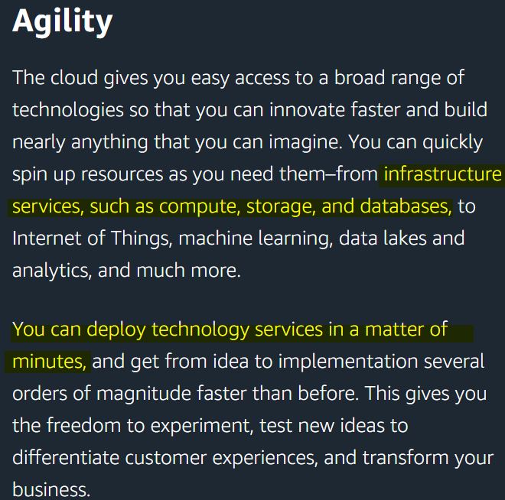

The Services Promise
Innovate faster
Build anything
Infrastructure services (compute and store)
Deploy in minutes
Freedom to experiment
MS Azure, IBM, Google… all make similar claims. The cited advantages are the emergent properties of a services-oriented architecture (SOA), not of any particular vendor.
Note compute and store

Slide 12
The Present State
Thus, in the wider IT world, the API has become the dominant thinking mode.
Developers now write services+API rather than dedicated desktop or web apps.
Business users integrate the services to create an application or dynamic content.
I’m calling this the Jigsaw Model – assemble the shapes at their API boundaries
Integration becomes implicit – the shapes fit together according to how you call their APIs

Slide 13
Meso: Market Research as Services
We need storage and compute, but
  standard storage formats (mostly RDBs) are bad for survey data, and
  BI crosstabulation is primitive by MR standards
The wider IT/web/cloud world won’t adapt to our unique requirements - we must adapt instead to theirs.
Require services to
send/receive case data
process case data (clean, net, create banners, derived variables)
crosstabulate
export to client deliverables
#1 is covered by TSAPI (Transfer Survey API)
#2, 3 and 4 depend on the crosstab software
The RCS Carbon libraries (as carbon to life, so crosstabs to MR) provide these services.

Slide 14

Carbon: DP and Crosstab Services
Carbon is a lightweight fully professional general cross-platform data processing and cross tabulation library suitable for batch processing or embedding in desktop or online applications.
Supported on Windows client and server operating systems, macOS, Linux and Unix. Library APIs can be published through in-house or cloud-hosted web services and consumed by client applications running in the web, on desktops or on mobile devices.
The library can be called from MS Office VBA, C#, VB.Net, F#, Python, Powershell and many other languages.

Slide 15
For Data Processing and Analysis
Under the Jigsaw Model:
Field collects and stores internally
Survey collection exposed to a TSAPI service caller
There exists a crosstab library which implements TSAPI
Agency DP uses a library service to get case data by calling the Field’s API
Agency DP, analysts, clients analyse the case data using the crosstab service

Slide 16
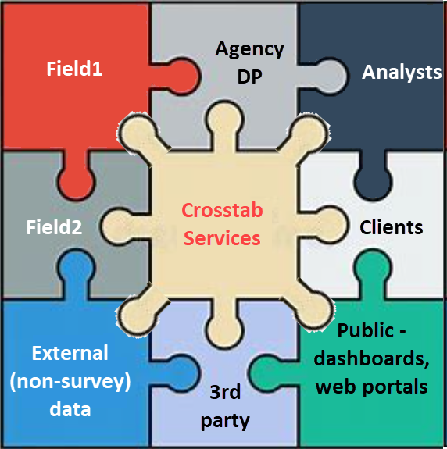



Old vs New
The Jigsaw Model
Raw Data Data Processing Analysis&Reporting
Many bridges and different file formats
SAV,SSS,DDF…
Cleaned, ready for analysis
DP
Field
Several BFAs
Analysts
JSON, HTML
Excel, PPT, PDF
Dashboard,Portals
Client

Slide 17
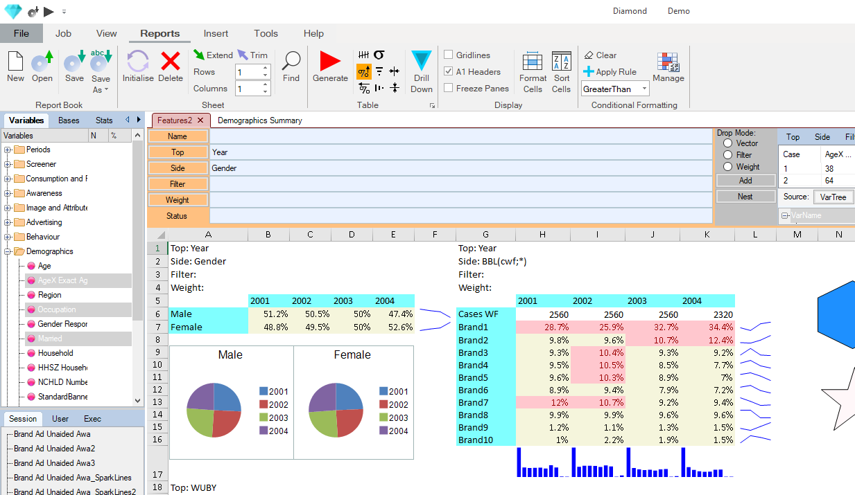
The Micro View: Real World Examples
Integrate Excel with a crosstab service which reads Cloud storage
  Instead of moving the crosstab outputs to Excel (cross a bridge), move the crosstabulator into Excel (integration)
Diamond
  Interactive document builder
  A new approach to crosstabulation
  (inspired by Jupyter notebooks)
  Integrates tables, dashboards and presentation
  C# GUI calls C++ DLL (the service)
Tableau
  Tableau is not designed for survey data, so we created an
  integration of crosstab and Tableau services to get the best of both – Matt will demo this if time - https://public.tableau.com/app/profile/matt.gibbs/viz/TrackingCovidSentiment/CovidSentiment
…business users are constantly exporting and manipulating data in Excel because they can’t get the view they need or aren’t comfortable using dashboarding tools ThoughtSpot-Dashboards-are-Dead.pdf

Slide 18
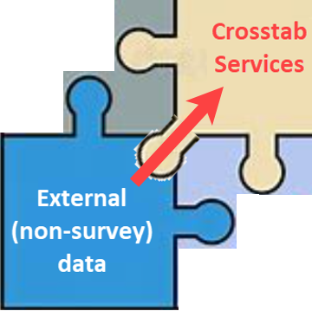
How to crosstabulate non-survey data?
To adapt to wider world of services, we need to be able to handle quantitative case data as easily as categorical.
The following examples use the UK Electricity supply and demand quantitative data (in megawatts).
Iain McKay earlier talked about how to get survey data into an RDB.
Here I show some techniques for going the other way.

Slide 19
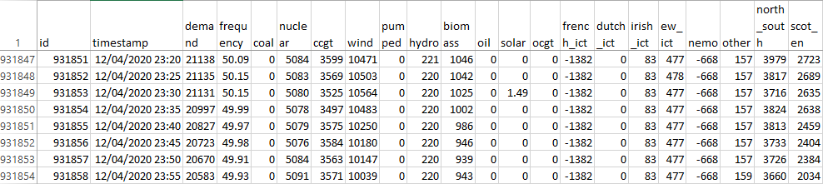
The UK Power Grid
What do you do with a million rows like this?
Apart from id and timestamp, all variables are quantities. The only Count procedure would be a histogram.
But I want a table of Consumption by Type by Hour of Day, or Wind delivery by Day of Week within Year.
Yes, could be done in Excel, but very labour-intensive, and I’m about to reach the Excel row limit (1,048,576).
And I also want to be able to quickly specify and execute new tables using my crosstabulation service.

Slide 20
Coded Increments
The concept of a coded increment comes from Surveycraft
It is an elementary combination of a categorical code and a quantitative value as code*value
For example, if the code for Widgits is 3, and I paid $10.00 for a widget, then this is stored as 3*10.0
At crosstab time, the cell indexed by code 3 is incremented by 10.0
In effect, each code instance can be differently and independently weighted
Not all crosstab systems directly support this concept
What brands did you last buy?
Widget
$10.00
How much did you pay?
Loop
BL_1: Gizmo
BL_2: Gadget
BL_3: Widget
Source
As Coded Increments
Crosstab
CaseID | BL_1 | BL_2 | BL_3 | … | BL_n | PR_1 | PR_2 | PR_3 | … | PR_n
1 | 0 | 0 | 1 |  |  |  |  | 10.0
2 | 1 | 1 | 1 |  |  | 8.99 | 12.5 | 12.0
CaseID | BL_PR
1 | 3*10.0
2 | 1*8.99;2*12.5;3*12.0
 | Gizmo | Gadget | Widget
Base | 1 | 1 | 2
Sum | 8.99 | 12.5 | 22
Avg | 8.99 | 12.5 | 11
22/2 = 11

Slide 21
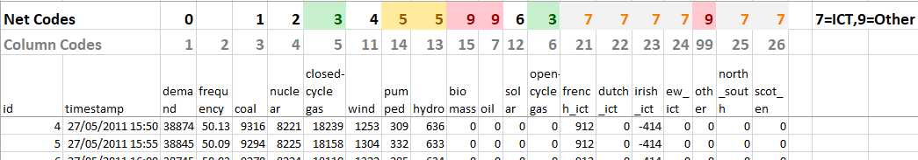
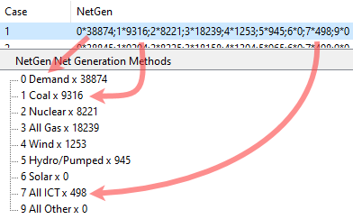
Representing the Data as Coded Increments
Assign a unique code and a net code to each column
Read the file, writing column code*cell value for each cell
DayOfMonth
MonthOfYear
Year
HourOfDay
MinuteOfHour
Economical
Safe – no risk of associating the wrong increment in table specs
And from the timestamp:
Hour (77,000 codes)
Day (3,200 codes)
Week (460 codes)
Month (108 codes)
Quarter (37 codes)

Slide 22
Call the Crosstab API
With formatted case data in hand, I can call the crosstab service API for generating a table from any supporting platform as
GenTab(name, top variable, side variable, filter)
For a table of Demand by Type by Hour of Day for 2016/2020 the arguments are
GenTab(“DuckCurve”, “HourOfDay”, “NetGen”, “Year(2016/2020”)
Then display as proportions (col%s with no % sign and no *100) to get the averages as
        sum of readings/base as number of readings

Slide 23
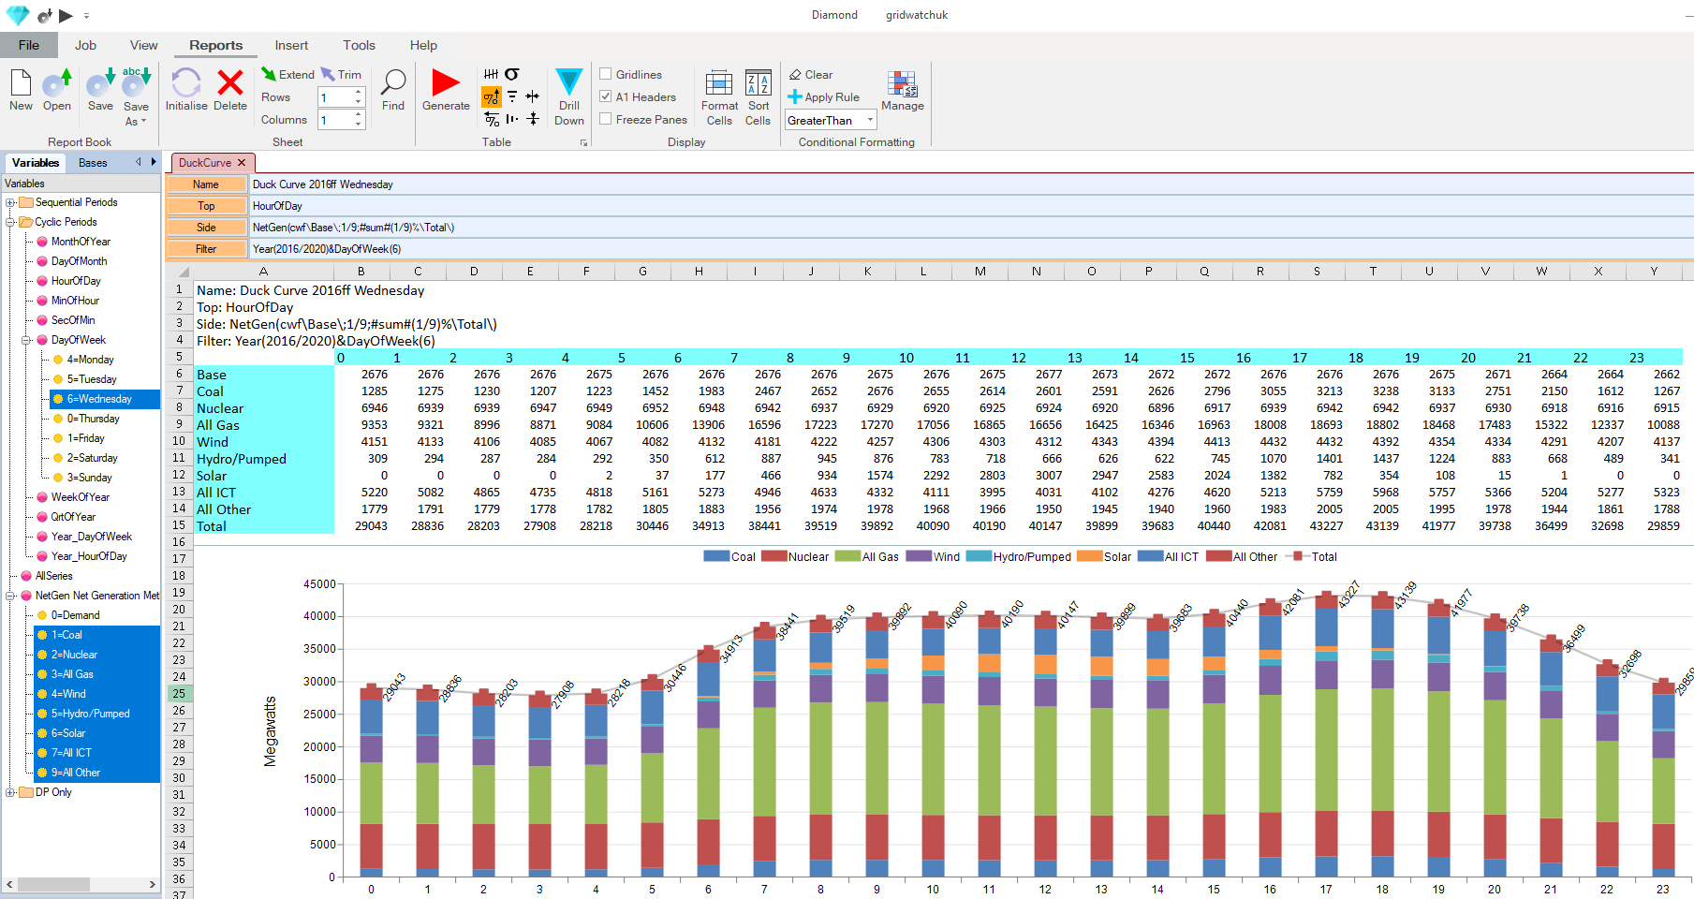
Duck Curve Table and Chart
C# GUI for calling TSAPI, Carbon, other services
Send these arguments to the C++ GenTab API
Excel-compatible spreadsheet as the work surface for display and chart

Slide 24
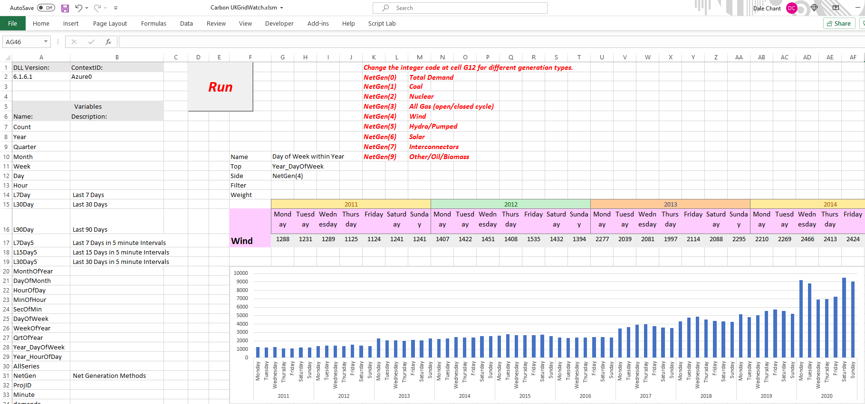
Daily Wind – Interactive Excel Workbook
User can edit an API element and Run to instruct the service to execute the change

Slide 25
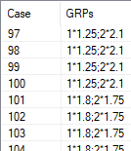
Pre-aggregates as Coded Increments
The second conference theme is using non-survey data to contextualise the information captured in surveys
What to do with things like media weight as Gross Rating Points or warehouse withdrawals supplied as weekly aggregates?
Week | 1-Jan-01 | 8-Jan-01 | 15-Jan-01 | 22-Jan-01 | 29-Jan-01 | 5-Feb-01
Execution1 | 62.5 | 62.5 | 90 | 90 | 90 | 90
Execution2 | 105 | 105 | 87.5 | 87.5 | 87.5 | 87.5
 | 1-Jan-01 | 8-Jan-01 | 15-Jan-01 | 22-Jan-01 | 29-Jan-01 | 5-Feb-01
Base | 50 | 50 | 50 | 50 | 50 | 50
Divide the aggregate by the base and express as coded increments
 | 1-Jan-01 | 8-Jan-01 | 15-Jan-01 | 22-Jan-01 | 29-Jan-01 | 5-Feb-01
Exe1 Increment | 1.25 | 1.25 | 1.8 | 1.8 | 1.8 | 1.8
Exe2 Increment | 2.1 | 2.1 | 1.75 | 1.75 | 1.75 | 1.75
62.5/50 = 1.25
105/50 = 2.1
1*1.25 ; 2*2.1 for cases 1/100

Slide 26
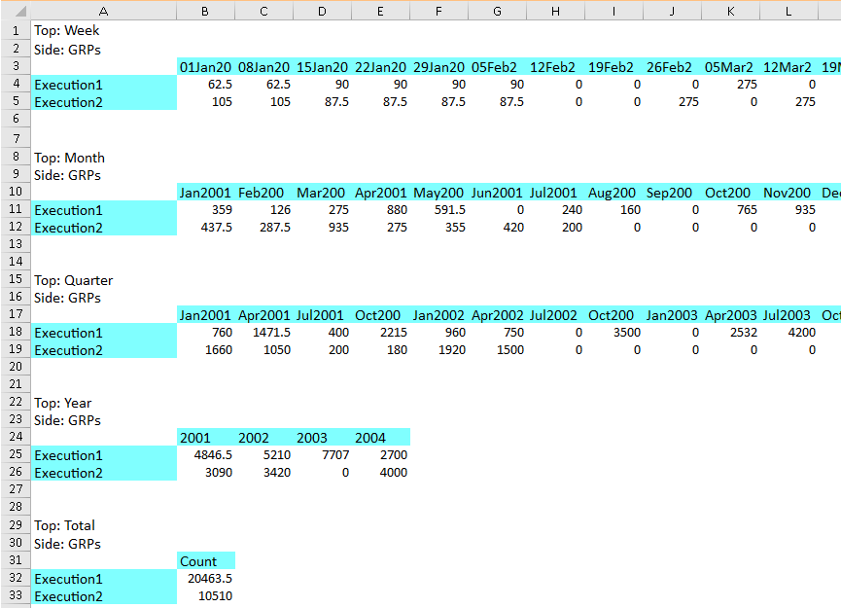
GRPs Period Tables
Tables of Month, Quarter, Year and Total now aggregate seamlessly

Slide 27
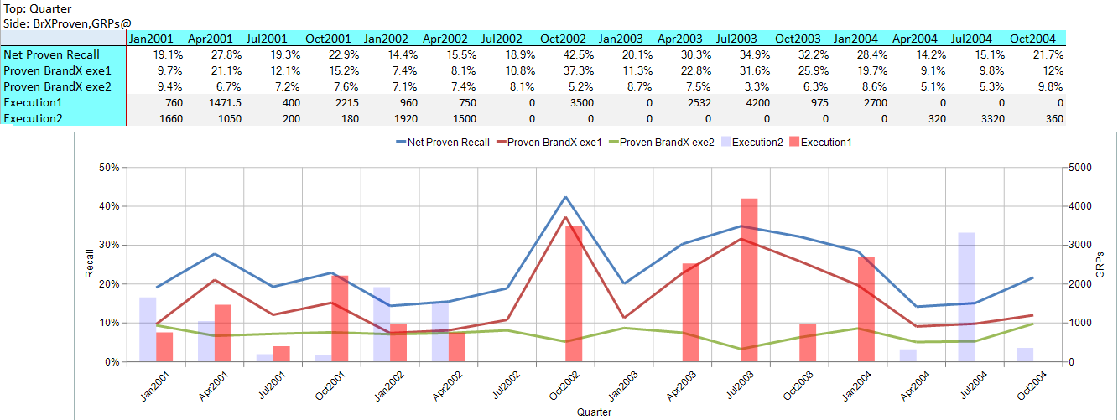
Contextualisation
Can now specify a single table with Recall and GRPs on the side

Slide 28
Conclusion
Modular services are the latest attempt to bring order to the chaos
TSAPI and Carbon are designed to work under a Services Oriented Architecture
For more on the UK Power grid see
https://www.redcentresoftware.com/2019/01/29/quantitative-jobs-2-uk-power-grid-demand-and-supply/
Any questions?
Email: dale@redcentresoftware.com

